Slide 1
Imagery

Slide 2
Representation of Knowledge
How do we represent everything we know and see in our minds?

Slide 3
Representation of Knowledge
Perception Based Knowledge Representation
  The representation has most of our perceptual experience.

Slide 4
Representation of Knowledge
Why do we care?
  Studying how our minds organize and use information we get from the outside world.

Slide 5
Imagery
Embodied Cognition
  The brain regions involved in imagining things are the same as actually doing them.
  Example: singing to yourself = Broca’s

Slide 6
Imagery
Motor cognition – mental processing in which motor system draws on stored info to plan action
  Similar to embodied cognition

Slide 7
Imagery
Shared motor representation – our ability to mentally represent actions made by others
Motor imagery – mentally simulating an intended action

Slide 8
Imagery
Experiments in:
  Verbal and Visual (perception based)
  Motor

Slide 9
Verbal and Visual Imagery
Dual Code Theory
  Separate representations for verbal and visual information
  Remember information better if it is encoded in two different ways

Slide 10
Example Experiment
Showed spatial arrangement of words and objects
Remember the most when the two layouts where the same

Slide 11
RECTANGLE
CIRCLE TRIANGLE

Slide 12
Mental Rotation
Studying how we rotate visual images

Slide 13

Which of these is the Same?
R
1 2

Slide 14

Rotate Clockwise
R
1 2

Slide 15
Rotate Counterclockwise
R
1 2

Slide 16

Rotate 180
R
1 2

Slide 17
Imagery and Rotation
Shepard and Metzler’s classic research (1971)
Are these the same object?
Used both reaction time and degree of rotation

Slide 18
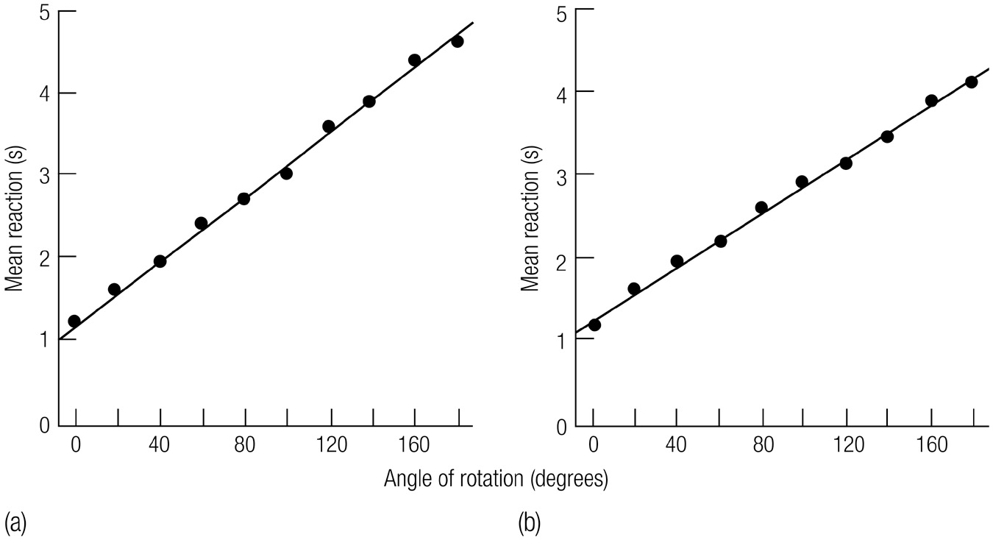

Shepard & Metzler’s Findings
Picture Plane
Depth

Slide 19
Recent Research on Mental Rotation
Rotate familiar figures faster
Rotate clear pictures faster than blurry ones
Slower as we age
Deaf fluent in ASL are very skilled in rotation
Notes:
Which of these are top-down, and which are bottom-up
Rotate familiar figures faster TD
Rotate clear pictures faster than blurry ones DEPENDS
Slower as we age TD
Deaf fluent in ASL are very skilled in rotation TD

Slide 20
Motor Cognition
Beilock – testing how athletes brain’s work.
  Groups:
    Hockey Players
    Football Players
  Variables
    IV: Type of Question (match, nonmatch)
    IV: Match to sport (neutral, hockey, football
    DV: reaction time

Slide 21
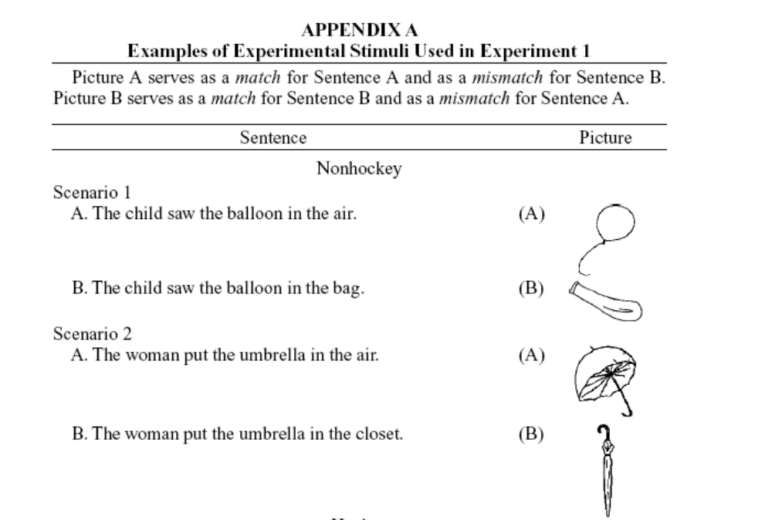
Motor Cognition

Slide 22
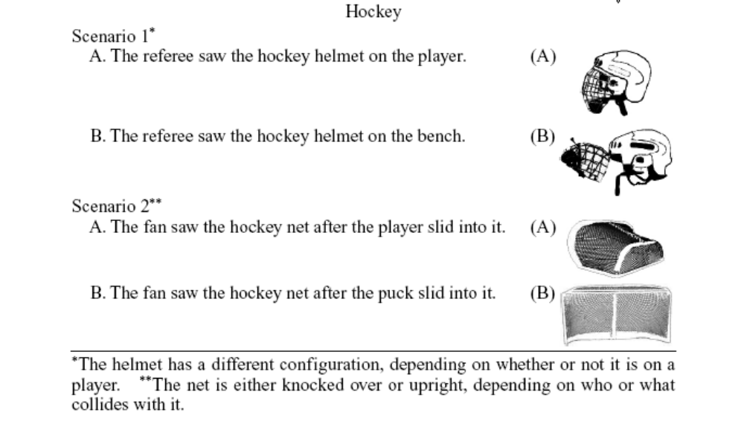
Motor Cognition

Slide 23
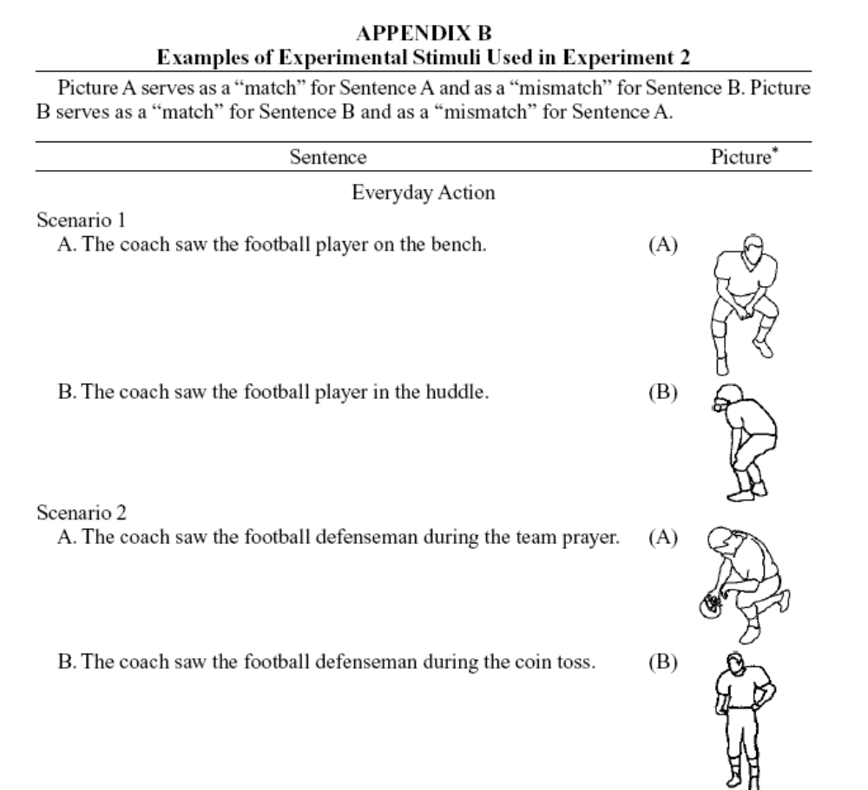
Motor Cognition

Slide 24
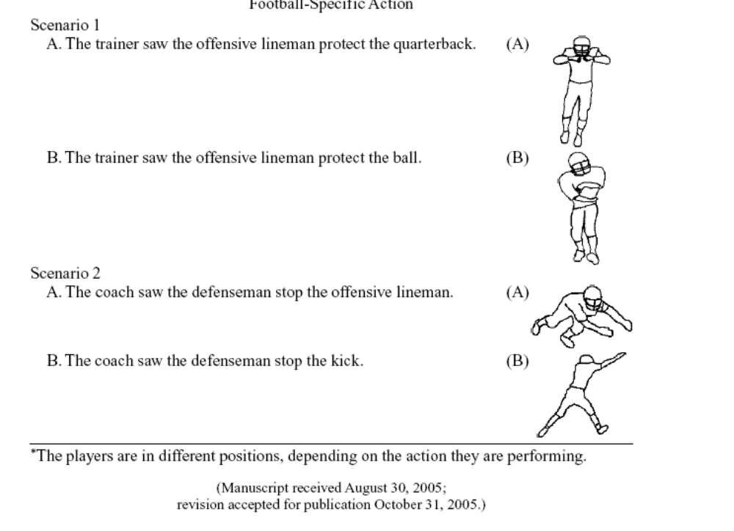
Motor Cognition

Slide 25
Motor Cognition
What she found:
  Sentences that matched were faster.
  Sentences that matched your expertise were faster.

Slide 26
Motor Cognition
So what?
  Faster = more brain parts are working on it.
  More parts = don’t have to think as hard.

Slide 27
More Experiments
In Embodied Cognition
  Baseball players
  Typing study (expert typists)

Slide 28
Baseball Study
IV: Expertise at baseball
DV: judging how well they hit the ball

Slide 29
Baseball Study
So, expert baseball players should be able to better predict their performance because they have more of the brain parts for it.
  They are “imagining”/motor imagery that they hit the ball well.

Slide 30
Baseball Study
But because of this motor imagery - they actually are not very good at predicting their own performance.

Slide 31
Typing Study
Pick your letter preference.

Slide 32
Typing Study
FV or DL
KI or SP
VT or NR
DW or AP

Slide 33
Typing Study
IV: skilled and novice typers
IV: letter dyads
  Same fingers
  Different fingers
DV: preference

Slide 34
Typing Study
The idea:
  Experts will prefer key press combinations that are easier to type.
  Things that are easier to type are on different hands.

Slide 35
Typing Study
People didn’t notice that they were on different hands - so this has to be a motor cognition idea.

Slide 36
Typing Study
Who prefers what?
  Novices don’t show a difference in preference
  Experts prefer the different finger groups.

Slide 37
Cognitive Maps
Cognitive Map: mental representation of relationships in external environment
The way we represent geographic space
  How do you get to your car from here?

Slide 38
Types of Cognitive Maps
Route Maps: How to get from A to B
  Route specific
  Early/novice

Slide 39
Types of Cognitive Maps
Survey Maps: Representation of space/ arrangement
  Route independent
  Info about spatial arrangement
  Later

Slide 40
Types of Cognitive Maps
Egocentric:
  First person point of view
Allocentric:
  Perspective independent

